Slide 1
APUSH Review: Key Concept 5.1 (Revised)
Everything You Need To Know About Key Concept 5.1 To Succeed In APUSH

Slide 2

Key Concept 5.1
“The United States became more connected with the world, pursued an expansionist foreign policy in the Western Hemisphere, and emerged as the destination for many migrants from other countries.”
Page 53
Big Idea Questions:
What were the social, economic and political impacts of Manifest Destiny and westward expansion?
What were reasons for, and goals of the nativist movement that emerged during this time?

Slide 3
Key Concept 5.1, I
“Popular enthusiasm for U.S. expansion, bolstered by economic and security interests, resulted in the acquisition of new territories, substantial migration westward, and new overseas initiatives.”
Page 53
A) Reasons for westward migration:
Access to natural and mineral resources
California Gold Rush (1840s)
Comstock Lode - silver, settlements built around resources
Economic opportunities:
“Safety-valve” theory - idea that one could always pack up and move out west and make $
Religious refuge:
Mormons, led by Brigham Young, moved west to Utah

Slide 4
Key Concept 5.1, I
B) Reasons for Manifest Destiny:
Spread US institutions and beliefs
Economic motives - access to land
C) Ways the US gained land:
Mexican-American War:
US defeated Mexico, gained the Mexican Cession
Negotiations:
Gadsden Purchase
Oregon Territory
This land acquisition led to debates over:
Slavery - Wilmot Proviso - sought to ban slavery in Mexican Cession; Free Soil Party - non extension of slavery
Status of Natives and Mexicans - how would they be incorporated?
Mexicans were given a choice to become US citizens or move to other parts of Mexico

Slide 5
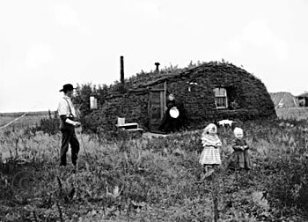
Key Concept 5.1, I
D) US government encouraged westward expansion
Homestead Act (1862):
Provided 160 acres of land with the promise to live on and improve the land for 5 years
Government provided subsidies to RRs
E) US sought initiatives with Asia:
Matthew Perry and the “opening” of Japan (1850s)
Clipper ships allowed for increased and faster trade with China (tea)
Missionaries were established in China to spread Christianity

Slide 6
Key Concept 5.1, II
“In the 1840s and 1850s, Americans continued to debate questions about rights and citizenship for various groups of US inhabitants.”
Page 54
A) Immigration from Europe and Asia
European Immigrants:
Irish - settled in cities in the Northeast, mostly Catholic
Germans - settled on the “frontier” - Midwest - as farmers
Many immigrant children attended parochial schools
Asian Immigrants:
Chinese immigrants settled on the West Coast in the 1850s
Worked in gold mines, factories, and farming
Later, the Chinese Exclusion Act (1882) forbid Chinese immigration
Both immigrants settled in ethnic communities and preserved their own cultures

Slide 7
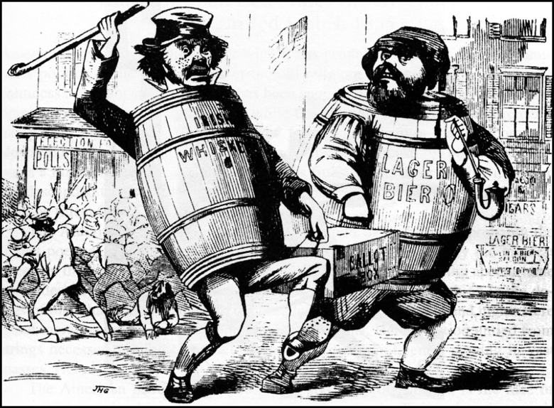
Key Concept 5.1, II
B) Emergence of NATIVISM:
Anti-Catholic
Sought to limit immigrants’ political power
Know-Nothing Party - anti-immigrant and anti-Catholic, sought to limit the power and influence of immigrants
C) Conflicts with Mexican Americans and Natives:
Sand Creek Massacre (1864)
CO militia attacked Cheyenne Indians, killed over 100, mostly women and children
Little Big Horn (Custer’s Last Stand) - Natives attacked and killed Custer and his men
US sought to assimilate many Natives with the expectation they would adopt white ways

Slide 8
Test Tips
Multiple-Choice and Short Answer:
Reasons for Manifest Destiny
Impacts of Mexican-American War on slavery
Ways the US encouraged westward expansion
Nativism - causes and examples
Essays:
How westward expansion led to tensions over slavery
Comparing experiences of immigrants with other time period

Slide 9
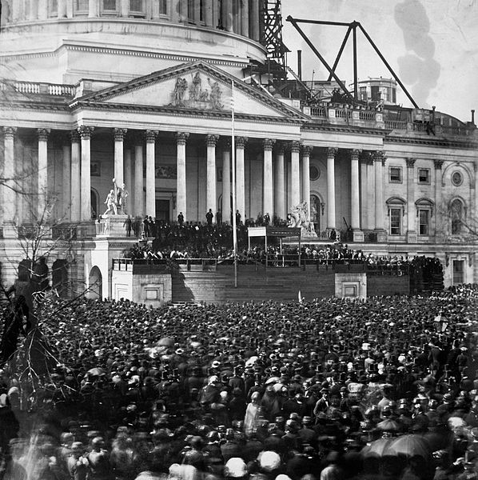
See You Back Here For 5.2!
Thanks for watching
Good luck in May!

